Slide 1
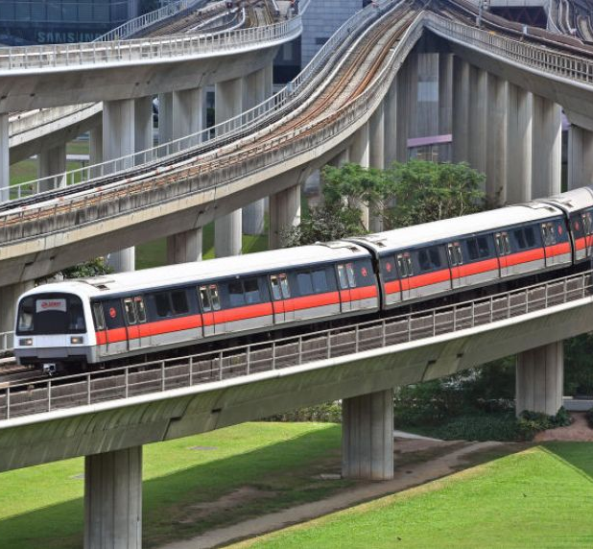
Mass Rapid Transit System Line Simulation
Team 14
Lee Min Shuen
Samuel Sim Wei Xuan
40.015 Simulation Modeling and Analysis | Term 06 2021

Slide 2
Motivation
Our project is to simulate a Mass Rapid Transit (MRT) System Line of Singapore. In our simulation model we used the example of the Downtown (Blue) Line which is connected to our Singapore University of Technology and Design.
We aim to understand how the average waiting time of a passenger at each station vary according to different train interarrival times. In addition, we want to understand how safe distancing measures in Singapore during COVID times might impact the waiting times.
This project's objective is to enable insights such as how the Land Transport Authority might be able to modify the current subway service while ensuring satisfactory waiting times.
40.015 Simulation Modeling and Analysis | Mass Rapid Transit System Line Simulation

Slide 3
Data Collection
Objective:
Obtain suitable passenger arrival values for our Simulation model timeseries exponential distribution from LTA API.
Assumptions:
Peak hours are 0600hrs to 0900hrs (morning), 1700hrs to 1900hrs (evening).
Passenger arrivals at stations connected to more than 1 line are assumed to be spilt evenly between all connected lines. E.g. Passenger arrivals at CE1/DT16 are spilt into 2 evenly.
40.015 Simulation Modeling and Analysis | Mass Rapid Transit System Line Simulation

Slide 4
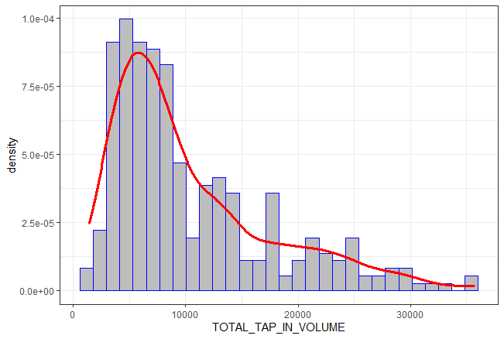
Data Visualization
Combined all three csv datasets into a single large dataset.
Split the single large data set into 6 categories:
Weekday Morning Peak;
Weekday Evening Peak;
Weekday Non-Peak;
Weekend Morning Peak;
Weekend Evening Peak;
Weekend Non-Peak.
Plot Histogram with density line for all categories.
Passenger Tap-In Volume for Weekday Evening Peak
40.015 Simulation Modeling and Analysis | Mass Rapid Transit System Line Simulation

Slide 5
Statistical Tests
Objective(s):
Determine if arrivals are different during morning peak, evening peak, and non-peak hours.
Determine if arrivals are different between each month.
How is it done:
Kruskal-Wallis tests used instead of ANOVA as responses are clearly not normally distributed.
40.015 Simulation Modeling and Analysis | Mass Rapid Transit System Line Simulation

Slide 6
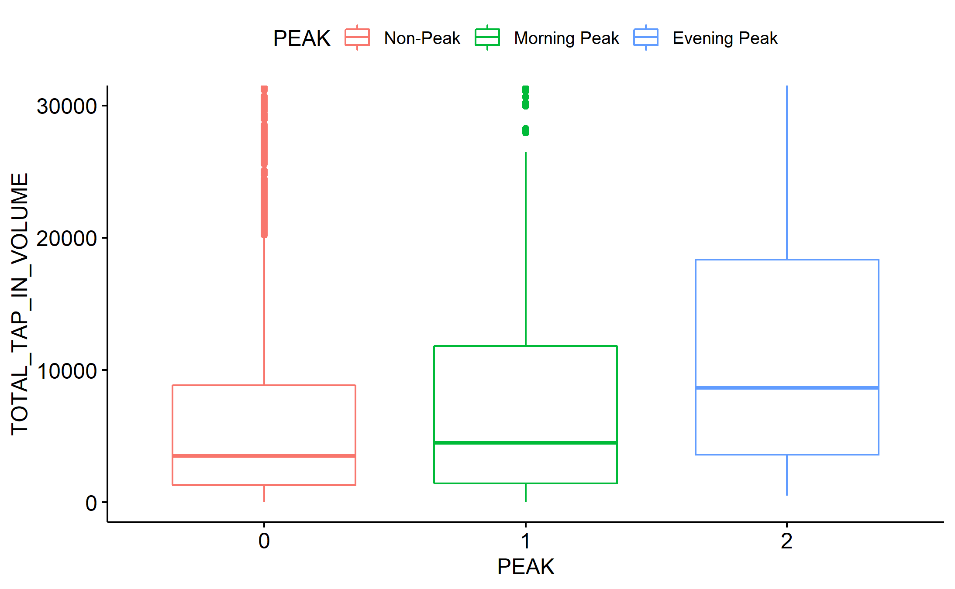
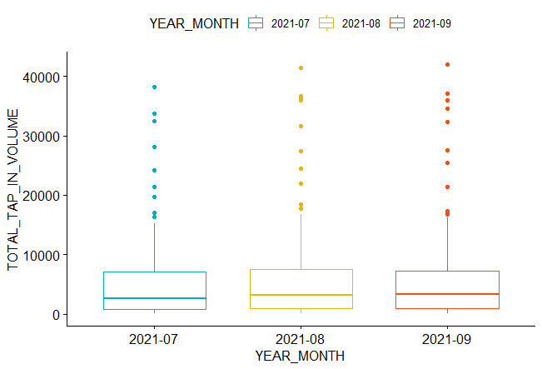
Statistical Test - Results
(Zoomed-in) Box-plot of the Passenger tap-in volume during weekday for July 2021.
Box-plot Passenger tap-in volume for weekday morning peak hours.
40.015 Simulation Modeling and Analysis | Mass Rapid Transit System Line Simulation

Slide 7
Simulation Parameters
Average number of passenger arrivals per hour:
 | Morning Peak | Evening Peak | Non-Peak
Weekday | 5100 | 7980 | 3480
Weekend | 840 | 1980 | 1380
From the above values, we can then sample and create timeseries data such that we can run 1 day (finite cycle) of simulation using the non-stat Exponential Distribution in JaamSim.
40.015 Simulation Modeling and Analysis | Mass Rapid Transit System Line Simulation

Slide 8
Data Limitations
Regarding the data distribution:
Although we claim that the passenger arrivals follow a Poisson distribution, the sample mean is observed to exceed the sample variance (overdispersion).
Since the data is over dispersed, a Negative Binomial distribution might be more appropriate in providing an estimate for the passenger arrival rate.
Regarding the LTA API:
Data collected spans across 3 months - "2021-07", "2021-08", "2021-09“ as the LTA API only provides the arrival volume data from the three most recent months.
40.015 Simulation Modeling and Analysis | Mass Rapid Transit System Line Simulation

Slide 9
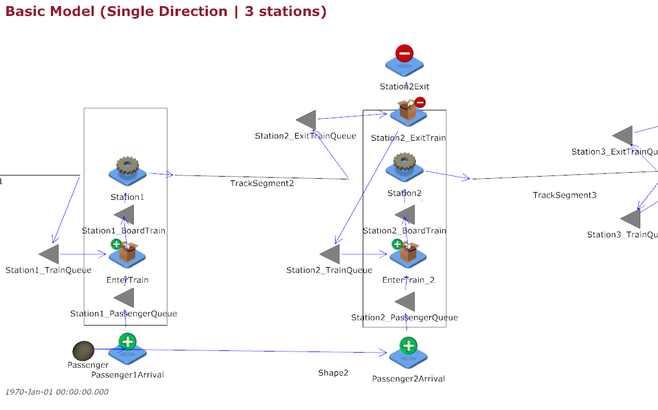
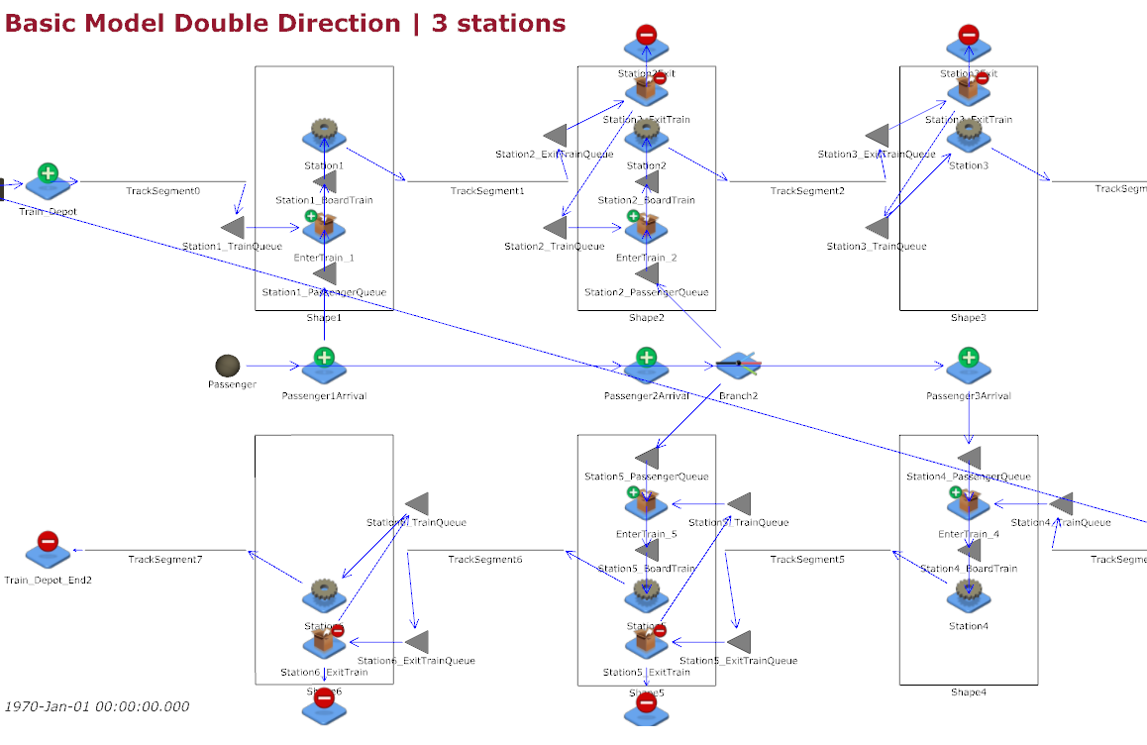
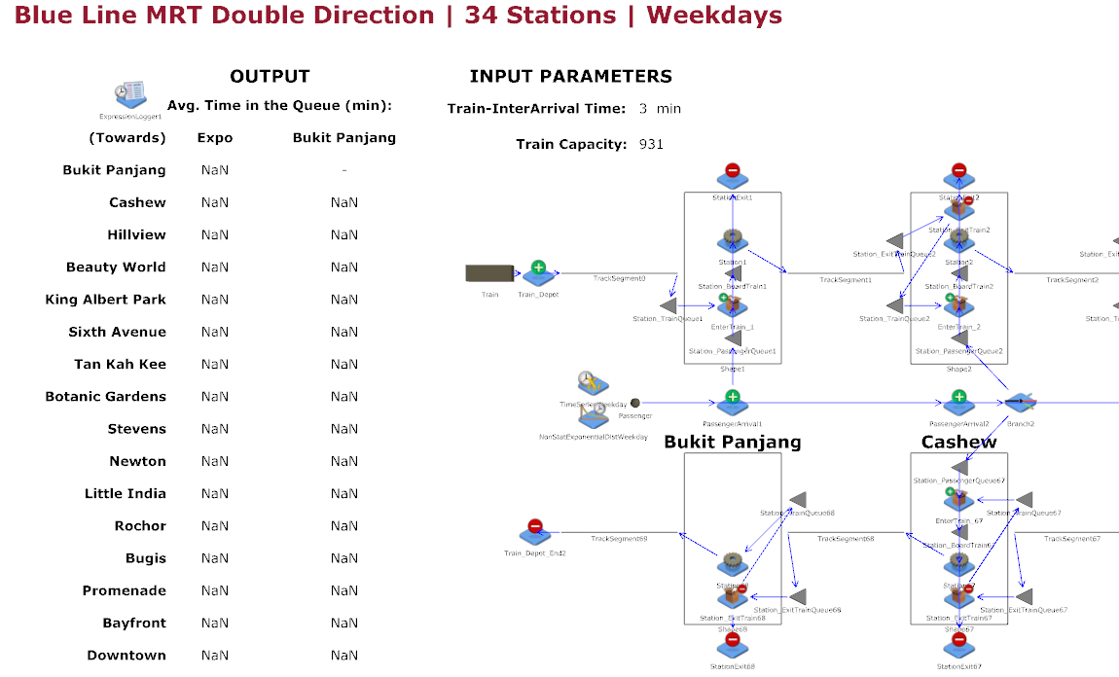
2 Variations of Model
1a) Simple Model 1: 3 Stations in 1 directions;
1b) Simple Model 2: 3 Stations in 2 directions;
2a) Complex Model (Weekdays) : Blue Line in 2 directions (34 Stations) on Weekdays;
2b) Complex Model (Weekends) : Blue Line in 2 directions (34 Stations) on Weekends.
40.015 Simulation Modeling and Analysis | Mass Rapid Transit System Line Simulation

Slide 10
Model Assumptions
Train Interarrival times from the depots are constant, subjected to user input.
Passenger arrivals at each station are i.i.d Poisson distributed, with varying mean rates according to the timeframe (Morning Peak hours, Evening Peak hours and Non-peak hours) and weekday/weekend.
Passenger departures at each station is proportional to current train occupancy.
Passenger arrivals at each station alternate between opposite directions.
To generalize and simplify our simulation, train operations are from 0500hrs to 0000hrs for both Weekday and Weekend.
Note most of these assumptions are regarding the parameters of the Simulation model which LTA would be able to provide better estimates.
40.015 Simulation Modeling and Analysis | Mass Rapid Transit System Line Simulation

Slide 11
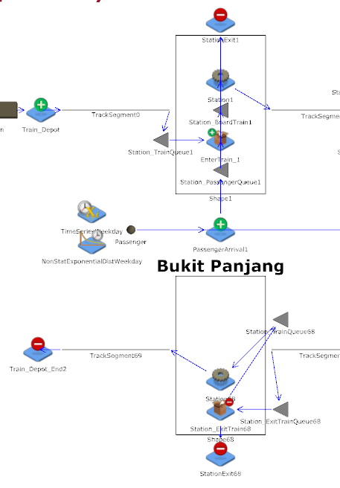
Extreme End Stations
Two rectangular shapes to represent both sides of the MRT platforms going in the opposite direction. For example, Bukit Panjang: The top shape represents it as the 1st station and the bottom shape represents the last station of the line.
Note the shapes are not mirror images. This is because passengers only board at the 1st station and only alight at the last station.
40.015 Simulation Modeling and Analysis | Mass Rapid Transit System Line Simulation

Slide 12
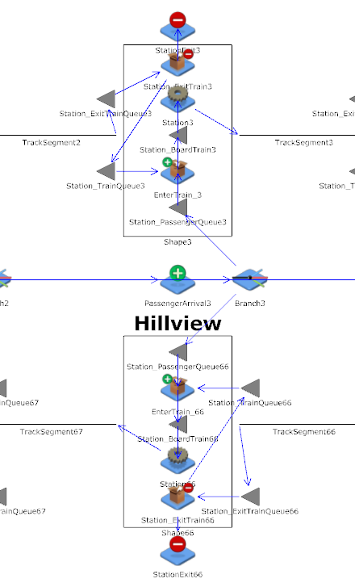
Middle Stations
Two rectangular shapes to represent both sides of the MRT platforms going in the opposite directions.
Note the middle stations’ shapes are mirror images. The reason is that unlike the Extreme End Stations, the passengers can choose to exit or board the trains for either direction.
40.015 Simulation Modeling and Analysis | Mass Rapid Transit System Line Simulation

Slide 13
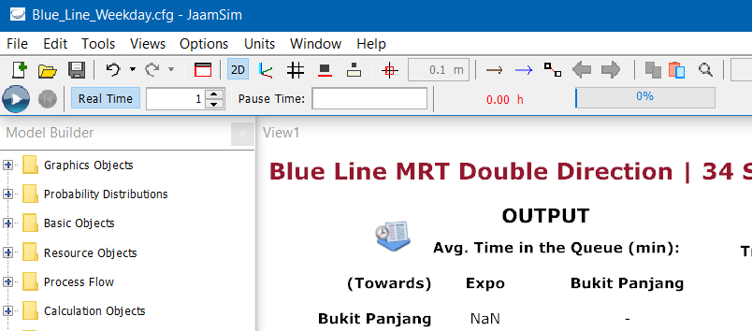

Simulation Run
Simulation run time: one day (1440 min)
Output Analysis: 100 repetitions to provide a better overall estimate after averaging across all simulations.
40.015 Simulation Modeling and Analysis | Mass Rapid Transit System Line Simulation

Slide 14
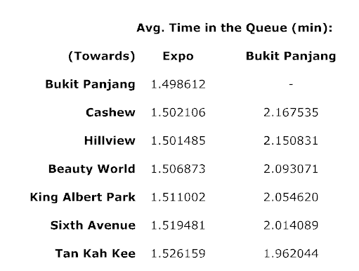
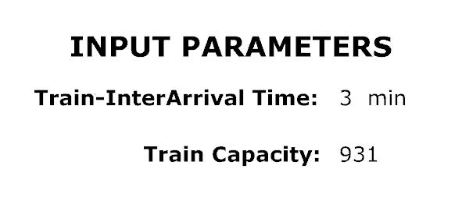
High Level Overview
Output
Input
Complex Model
40.015 Simulation Modeling and Analysis | Mass Rapid Transit System Line Simulation

Slide 15

Common Random Number
To reduce the variance in our results such that any observed differences between models (if any) is due to the different configurations and not random conditions.
JaamSim uses the same default GlobalSubstreamSeed in the Simulation Parameters since the GlobalSubstreamSeed is not specified.
Hence this uses the same Global Seed for the different .cfg models.
40.015 Simulation Modeling and Analysis | Mass Rapid Transit System Line Simulation

Slide 16
Output Analysis 1
Control run:
Using parameters obtained from collected data
2 Runs: Weekdays and Weekends
We want to simulate and analyze:
What happens to average time spent in passenger queue if safe-distancing measures are enforced in MRT trains;
Intuitively, the average time should not change if the MRT capacity is large enough.
This is done by running the simulations (also 100 repetitions and averaged) and with a lower train capacity (half), and then analyzing the average waiting time of each station against the control run.
40.015 Simulation Modeling and Analysis | Mass Rapid Transit System Line Simulation

Slide 17
Output Analysis 2
Control run:
Same control run results used.
We want to simulate and analyze:
How does decreasing the interarrival times of trains leaving the depot help to decrease the average waiting time in the queues?
This is done by running the simulations (similarly 100 repetitions and averaged) with a lower train interarrival time, and then analyzing the average waiting time of each station against the control run.
40.015 Simulation Modeling and Analysis | Mass Rapid Transit System Line Simulation

Slide 18
Visualization - Weekday
Decrease Train Capacity:
Similar average waiting time to control.
Decrease Train Interarrival Time:
Lower average passenger waiting times.
Note only 1 direction is being shown.
To view the animation, use the link in the html page.
40.015 Simulation Modeling and Analysis | Mass Rapid Transit System Line Simulation

Slide 19
Visualization - Weekend
Decrease Train Capacity:
Similar average waiting time to control.
Decrease Train Interarrival Time:
Lower average passenger waiting times.
Note approximately similar results were observed for both weekend and weekday.
40.015 Simulation Modeling and Analysis | Mass Rapid Transit System Line Simulation

Slide 20
Performances of Systems
Pairwise t-tests (Control vs Alternative):
Control vs Lower Train Capacity (Covid Period) for Weekday;
Control vs Lower Train Capacity (Covid Period) for Weekend;
Control vs Lower Train Interarrival Timing for Weekday;
Control vs Lower Train Interarrival Timing for Weekend.
Compared the expected performance measure (daily average waiting time) across 100 simulations (100 days) between the two systems for the 4 cases above.
Identified the 95% level confidence interval of the difference (Control Mean – Alternative Mean), between the expected performance of the 2 systems.
40.015 Simulation Modeling and Analysis | Mass Rapid Transit System Line Simulation

Slide 21
Pairwise t-test Results
Control vs Lower Train Capacity (Covid Period) for Weekday:
No significance difference in performance
Control vs Lower Train Capacity (Covid Period) for Weekend:
No significance difference in performance
-1
0
0.5
1
Control vs Lower Train Interarrival Timing for Weekday:
Alternative has better performance (lower waiting time)
Control vs Lower Train Interarrival Timing for Weekend:
Alternative has better performance (lower waiting time)
40.015 Simulation Modeling and Analysis | Mass Rapid Transit System Line Simulation

Slide 22
Reflection
No occasions where passengers were unable to board the train due to full capacity - perhaps reduce the proportion of passengers exiting.
Possible use for countries planning to build a subway system as having to test these different trains capacity and arrival frequencies in real life would be costly and unpractical.
40.015 Simulation Modeling and Analysis | Mass Rapid Transit System Line Simulation

Slide 23
Model Extensions
Possible Extensions and Improvements to the Model:
Distinct passenger interarrival rates for each station and direction given more detailed data.
Passenger departures to follow a certain distribution instead of constant proportion.
More complex models extending from basic model:
Split tracks;
Consider passenger arrivals from other lines at connecting station;
Consider downtime entities in JaamSim (breakdown disruptions or signaling faults).
All stated improvements require more data to determine the parameter values and distributions.
40.015 Simulation Modeling and Analysis | Mass Rapid Transit System Line Simulation

Slide 24
THANK YOU
Team 08
Lee Min Shuen
Samuel Sim Wei Xuan
40.015 Simulation Modeling and Analysis | Term 06 2021

